Slide 1
Office 365 Development

Slide 2
Deep Dive into the Office 365 Unified API

Slide 3















Vision
EXTEND OFFICE EVERYWHERE
CONNECT TO OFFICE 365 SERVICES
BUILD USING AN OPEN PLATFORM
Delve
z
Users and groups
Files
Mail
Calendar
My Apps
Video Portal
Contacts
Office Graph
Presentations
Documents
Spreadsheets
Lync
OneNote
Yammer

Slide 4

Agenda
Why the need for Unified API
What is the Unified API
Unified API .NET SDK
Supported Areas
Roadmap

Slide 5
Why the need for the Unified API?

Slide 6








Data silos in the enterprise
USER
FILES
EMAIL AND CONVERSATIONS
EVENTS
PEOPLE
GROUPS

Slide 7
What is the Unified API

Slide 8
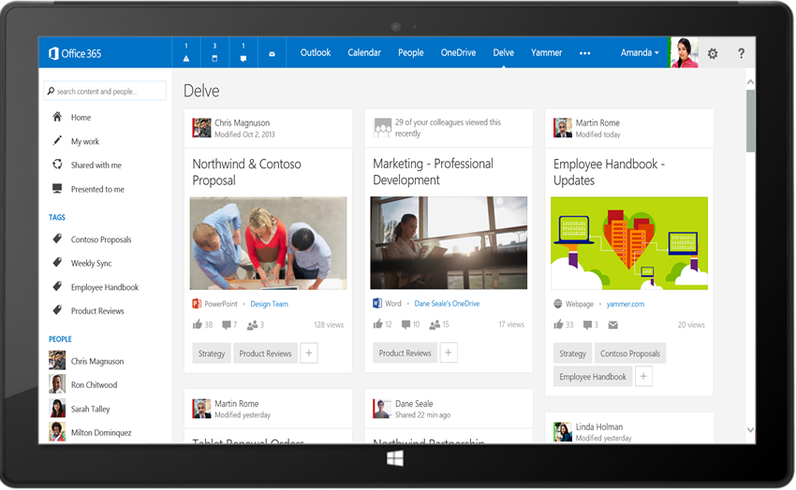
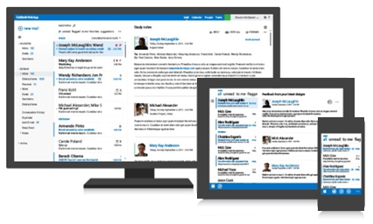
Office 365 unified API
Your App
https://graph.microsoft.com/
USERS
GROUPS
FILES
MAIL
CALENDAR
TASKS
Insights and relationships from Office Graph

Slide 9
demo
Exploring Azure Active Directory & Unified API

Slide 10
Breaking silos
USER
FILES
EMAIL AND CONVERSATIONS
EVENTS
PEOPLE
GROUPS

Slide 11
Benefits to Unified API
Single well-known endpoint
Single well-known resource
Only one OAuth access token needed
Navigate across workloads and features logically

Slide 12
/me
USER
ME
userPhoto
thumbnailPhoto
responsibilities
department
pastProjects
aboutMe
hireDate
birthday
address
mobile
jobTitle
schools
name
skills
tags
alias

Slide 13
Code
GET https://graph.microsoft.com/beta/contoso.com
/users/yina@contoso.com
GET https://graph.microsoft.com/beta/me
GET https://graph.microsoft.com/beta/contoso.com
/users/<id>
GET https://graph.microsoft.com/beta/contoso.com
/users/yina@contoso.com?$select=aboutMe
GET https://graph.microsoft.com/beta/me/userphotos/96X77

Slide 14
/users
manager
USER
directReports
memberOf
GROUPS

Slide 15
Code
GET https://graph.microsoft.com/beta/me/manager
GET https://graph.microsoft.com/beta/contoso.com
/users/yina@contoso.com/directReports
GET https://graph.microsoft.com/beta/me/memberOf
GET https://graph.microsoft.com/beta/contoso.com
/users/<id>
GET https://graph.microsoft.com/beta/contoso.com
/users/alex@contoso.com/directReports

Slide 16
/messages
manager
USER
directReports
memberOf
GROUPS
MESSAGES

Slide 17
Code
GET https://graph.microsoft.com/beta/me/messages
GET https://graph.microsoft.com/beta/me/messages?$top=5
GET https://graph.microsoft.com/beta/me
/messages?$top=5&$skip=5&$orderby=DateTimeCreated
GET https://graph.microsoft.com/beta/me
/messages?$top=5&$select=Subject,Sender&
$search="from:alexd@contoso.com"

Slide 18
/events
manager
USER
directReports
EVENTS
memberOf
GROUPS
MESSAGES
MESSAGES

Slide 19
Code
GET https://graph.microsoft.com/beta/me/events
GET https://graph.microsoft.com/beta/me/events?$top=5
GET https://graph.microsoft.com/beta/me
/calendarview?startdatetime=2015-04-01t01:00:00z
&enddatetime=2015-04-16t23:00:00z

Slide 20
/files
Shared with me
createdBy
public
manager
USER
directReports
directReports
EVENTS
EVENTS
modifiedBy
FILES
memberOf
GROUPS
MESSAGES

Slide 21
Code
GET https://graph.microsoft.com/beta/me/files
GET https://graph.microsoft.com/beta/me/files/<id>
GET https://graph.microsoft.com/beta/me
/files/<id>/lastModifiedByUser
GET https://graph.microsoft.com/beta/mary@contoso.com/files
GET https://graph.microsoft.com/beta/mary@contoso.com
/files/<id>/lastModifiedByUser/manager

Slide 22
/groups
Shared with me
Shared with me
createdBy
createdBy
CONVERSATIONS
public
public
manager
USER
directReports
directReports
directReports
directReports
EVENTS
EVENTS
modifiedBy
modifiedBy
FILES
FILES
memberOf
memberOf
GROUPS
GROUPS
createdBy
MESSAGES
FILES

Slide 23
Code
GET https://graph.microsoft.com/beta/contoso.com
/groups?$filter=groupType+eq+'Unified'
GET https://graph.microsoft.com/beta/contoso.com/groups/<id>/members
GET https://graph.microsoft.com/beta/contoso.com
/groups/<id>/files
GET https://graph.microsoft.com/beta/contoso.com
/groups/<id>/conversations
GET https://graph.microsoft.com/beta/contoso.com
/groups/<id>/events/<id>/accept

Slide 24
/workingWith
Shared with me
createdBy
CONVERSATIONS
CONVERSATIONS
public
manager
USER
workingWith
directReports
directReports
EVENTS
EVENTS
EVENTS
modifiedBy
FILES
memberOf
memberOf
memberOf
workingWith
GROUPS
GROUPS
GROUPS
createdBy
createdBy
MESSAGES
FILES
FILES

Slide 25
Code
GET https://graph.microsoft.com/beta/me/workingWith
GET https://graph.microsoft.com/beta/contoso.com
/users/yina@contoso.com/workingWith
GET https://graph.microsoft.com/beta/contoso.com
/users/mary@contoso.com/workingWith

Slide 26
/trendingAround
trendingAround
Shared with me
createdBy
CONVERSATIONS
public
workingWith
manager
USER
workingWith
directReports
directReports
directReports
EVENTS
EVENTS
trendingAround
modifiedBy
FILES
memberOf
memberOf
workingWith
workingWith
GROUPS
GROUPS
createdBy
MESSAGES
FILES

Slide 27
Code
GET https://graph.microsoft.com/beta/me/trendingAround
GET https://graph.microsoft.com/beta/contoso.com
/users/yina@contoso.com/trendingAround
GET https://graph.microsoft.com/beta/contoso.com
/users/mary@contoso.com/trendingAround

Slide 28
API
trendingAround
Shared with me
createdBy
CONVERSATIONS
public
manager
USER
workingWith
directReports
EVENTS
trendingAround
modifiedBy
TASKS
FILES
memberOf
workingWith
TASKS
GROUPS
createdBy
NOTES
NOTES
MESSAGES
FILES

Slide 29
API
trendingAround
Shared with me
createdBy
CONVERSATIONS
public
manager
USER
workingWith
directReports
EVENTS
trendingAround
https://graph.microsoft.com/
modifiedBy
TASKS
FILES
memberOf
workingWith
TASKS
GROUPS
createdBy
NOTES
NOTES
MESSAGES
FILES

Slide 30
demo
Exploring the Unified API via REST

Slide 31
Unified API Native SDKs

Slide 32
Unified API Native SDKs
Native SDKs available for all platforms supported by the Office 365 APIs
Native .NET SDK
NuGet Package: Microsoft.Graph

Slide 33
demo
Unified API .NET SDK

Slide 34
What is supported now?

Slide 35
Supported functionality
Users
Files
Mail
Calendar
Org. Contacts
Groups*
Social Activity*
Commercial
OAuth2.0
CORS
CRUD
OData query operations
Actions and functions
Client libraries .Net, Android, iOS

Slide 36
API
trendingAround
Shared with me
createdBy
CONVERSATIONS
public
manager
USER
workingWith
directReports
EVENTS
trendingAround
https://graph.microsoft.com/beta/$metadata
modifiedBy
TASKS
FILES
memberOf
workingWith
TASKS
GROUPS
createdBy
NOTES
NOTES
MESSAGES
FILES

Slide 37
What’s coming next?

Slide 38
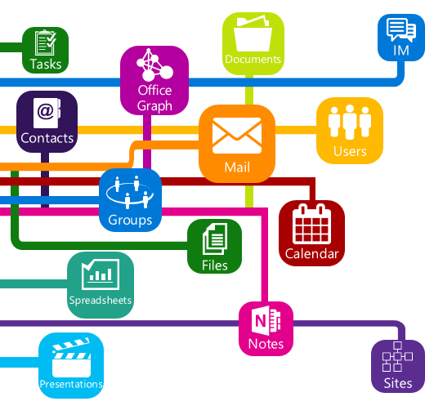
Roadmap
Notifications / web hooks
Consumer
Instant-on
Personal contacts
Tasks
Notes
Skype
Additional insights and relationships
Extensibility

Slide 39
Summary
Why the need for Unified API
What is the Unified API
Unified API .NET SDK
Supported Areas
Roadmap

Slide 40



dev.office.com
Sign up
http://dev.office.com/getting-started
Explore
http://apisandbox.msdn.microsoft.com
Get trained http://dev.office.com/training

Slide 41


Feedback
Office 365 Network Share you best practices and join conversations https://www.yammer.com/itpronetwork
Stackoverflow Ask deep technical questions to a world-wide set of developers
http://stackoverflow.com/questions/tagged/ms-office
UserVoice Provide suggestions of what you want in future versions
http://officespdev.uservoice.com/

